Slide 1
Employee Data Analysis using Excel
STUDENT NAME: Sangeetha J
REGISTER NO: 2213331042138
NM ID : FE15CE1C9032955B16848269FA6EA878
DEPARTMENT: COMMERCE
COLLEGE: Bharathi Women’s College

Slide 2
PROJECT TITLE
Employee Performance Analysis using Excel

Slide 3


AGENDA
Problem Statement
Project Overview
End Users
Our Solution and Proposition
Dataset Description
Modelling Approach
Results and Discussion
Conclusion
3/21/2024 Annual Review

Slide 4

PROBLEM STATEMENT
The Employee performance analysis is done to know their performance and their
Working status in the company through we can help them to improve their performance which
Will lead the whole organization achieve the goal.

Slide 5

PROJECT OVERVIEW
Analyzing the Employees’ performance by considering various factors such as the
the employee’s gender, first name, performance scores and levels and by sorting these in a
required form to make a clear opinion about their performance to improve their status and to
develop the company’s functions to achieve the goal.

Slide 6

WHO ARE THE END USERS?
Here is the list of the parties who are all benifited;
Employees’
Employers
Managers
Organization
Other parties involved

Slide 7

OUR SOLUTION AND ITS VALUE PROPOSITION
Conditional formatting
Conditional formatting is used to fill the blank cells with colour.
Filter
Filers are used to remove the blank cells in the columns or rows.
Pivot table
Pivot tables are used to determine the selected features the data set to arrange in
an understandable way to analyze.
Slicer
Slicers are used to analyze the different types of employees performance.
Graph
Graphs are used to visualize the performance of an employee in an easy way
That is pictorial representation.

Slide 8
Dataset Description
Employees dataset = Kaggle
Total features : 26
Features considered: 9
Emp ID
Employees first and last names
Department
Type
Performance rating
Performance level

Slide 9
MODELLING
Step 1
Download the dataset from the Kaggle website.
step 2
clearing the employees data by removing and filtering the blanks and error cells by using conditional
Formatting and filter option.
step 3
Converting the ratings into a (text form) of performance levels by using the formula
=IFS(Z8>=5,”VERY HIGH”,Z8>=4,”HIGH”,Z8>=3,”MED”, Z8<=2, “LOW”).
Step 4
Selecting the relevant features should be taken to analyze the employee performance.
Step 5
Transferring the selected features into the pivot table to analyze it with the view to make a
Rational decision of it.
Step 6
Using slicer convert the pivot table with an extra feature to view it in different perspective.
Step 7
Finally machining a chart using the recommended chart in the excel to by adding the trendline to
To analyze the MED and LOW rating count.
9

Slide 10
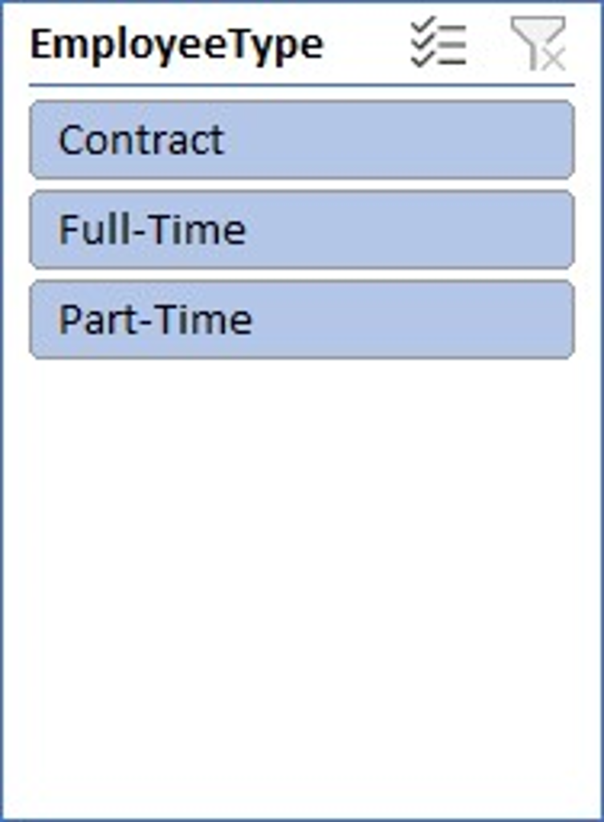
RESULTS
GenderCode | (All)
Count of FirstName | Column Labels
Row Labels | HIGH | LOW | MED | VERY HIGH | Grand Total
BPC | 19 | 34 | 86 | 11 | 150
CCDR | 21 | 41 | 68 | 15 | 145
EW | 19 | 42 | 77 | 16 | 154
MSC | 21 | 29 | 91 | 16 | 157
NEL | 23 | 38 | 78 | 15 | 154
PL | 21 | 40 | 72 | 10 | 143
PYZ | 21 | 48 | 71 | 17 | 157
SVG | 16 | 47 | 85 | 19 | 167
TNS | 25 | 46 | 68 | 11 | 150
WBL | 16 | 35 | 91 | 14 | 156
Grand Total | 202 | 400 | 787 | 144 | 1533
10

Slide 11
Result

Slide 12
conclusion
Hence the performance of the every employee is Identified by analyzing and interpreting the data into
Relevant table form and the trend will help us for the betterment of the company, staffs and
other parties involved to improve the employees performance level in future.

